Slide 1

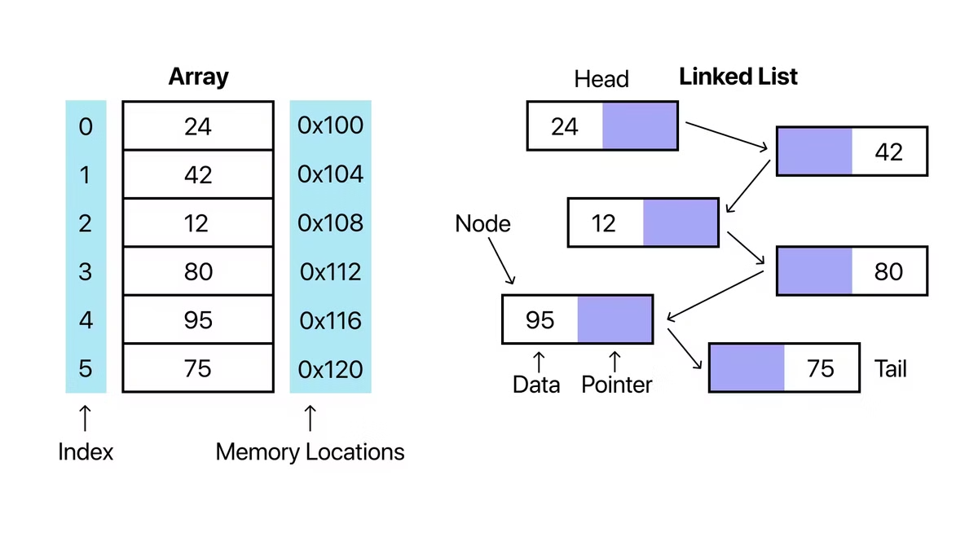

Algorithms [5SENG003W]
Week 2
by Prashastha Mudannayake

Slide 2
Last Week
What is an "Algorithm"?
How performance of algorithms can be compared?
Big-O notation
Some important complexity classes (logarithmic, linear, quadratic, exponential, ... )
How to determine them empirically (doubling hypothesis)

Slide 3
Topics to Cover
Involvement of Data Structures in algorithms.
Linear(Sequential) vs non-linear structures
Indexed vs linked structures
Ways of designing algorithms.
Strategies when designing algorithms (Greedy, Divide-and-Conquer)

Slide 4

Data Structures
What Data Structures do you know?

Slide 5
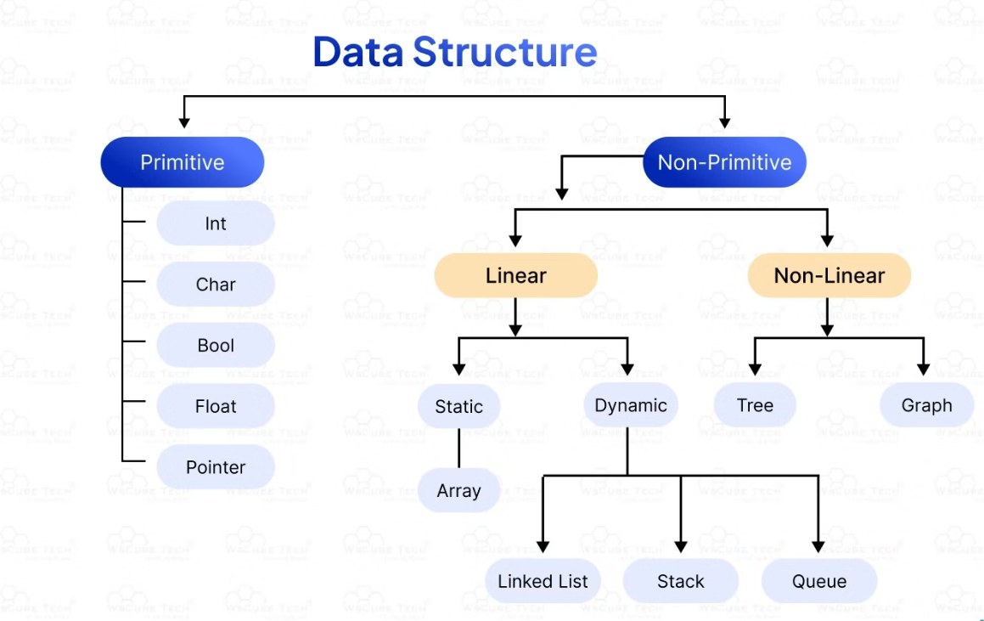
Data Structures

Slide 6


Structure matters
We have already seen how the size of the data affects the running time of algorithms.
The data structure can be just as important!
Different data structures offer different performance for elementary operations like insertion or lookup.
Let’s have a look at some examples.

Slide 7
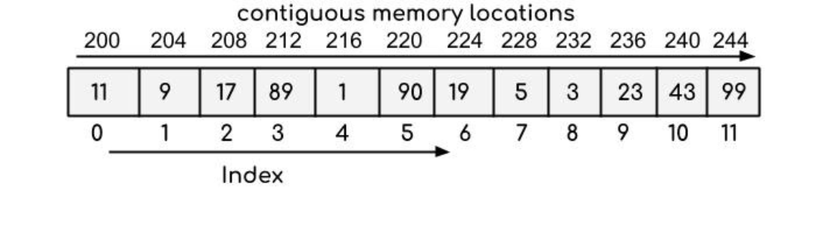
Sequential Data Structures: Arrays
One of the simplest linear data structures.
Laid out sequentially in memory.
Index based.
Usually fixed size and cannot easily be resized once initialized.
More versatile: Java ArrayLists and C++ vectors
These have flexible size, i.e. can grow to accommodate additional data.
For simplicity, the data contained in the structures will be integers.

Slide 8
Array vs. ArrayList
Initial Capacity:
When created a default capacity is assigned (typically 10)
Growth Factor:
When capacity is reached, ArrayList creates a new larger internal array
The new size is typically 1.5x the current size
All elements are copied to the new array

Slide 9
Array operations
Reading/writing at any given index: e.g. a[i] = a[i+1];
Cost: constant(O(1)) – independent of array size
Adding/removing at the end (in ArrayLists or Vectors)
Cost: constant(O(1)) – independent of array size [Adding amortized]
Adding/removing in the middle Cost: linear(O(n)) – must move the rest of the contents!

Slide 10

Time for an Array laugh

Slide 11
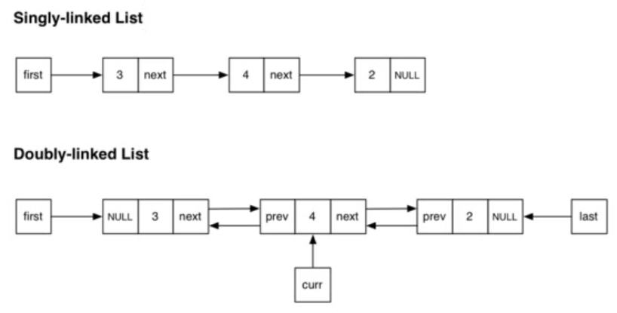
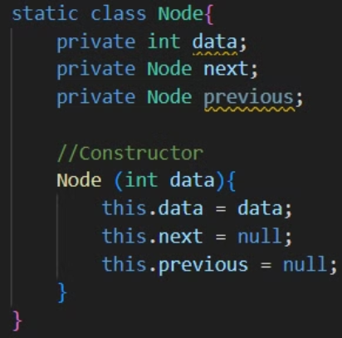
Sequential Data: Linked Lists
Simplest dynamic linear data structure.
A node is the basic building block.
Not necessarily laid out sequentially in memory.
"I'd traverse it myself, but it's singly linked, so I'm worried that I won't be able to find my way back to 2025."

Slide 12
Linked List operations
Reading/writing at any given position
Cost: linear (O(n)) – must traverse the list to find the position!
Adding/removing at the end
Cost: constant (O(1)) – independent of list size
Adding/removing in the middle
Cost: constant (O(1)) – assuming we have an iterator

Slide 13

Linked list interview question

Slide 14
Choice of data structure
Choice of data structure can influence what algorithms are suitable
Typically there is a trade-off between complexities of operations
We will be seeing other (non-sequential) structures later
Various kinds of trees
Graphs

Slide 15
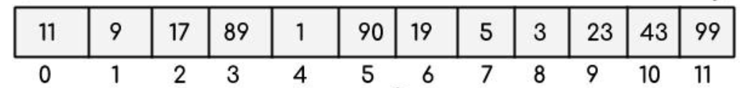
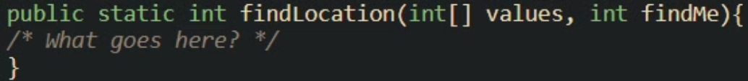
Example
Problem:
Given: a data structure, and a target value(s) to find.
Question: Is target value(s) in the structure? If yes, where?
Approach 1: Using array

Slide 16
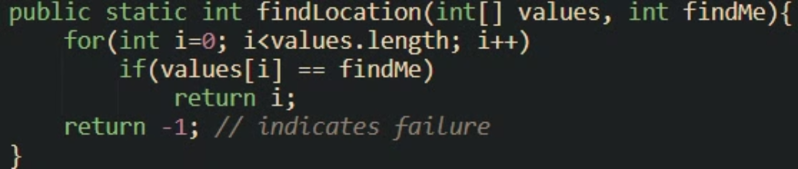
Example
Problem:
Given: a data structure, and a target value(s) to find.
Question: Is target value(s) in the structure? If yes, where?
Approach 1: Using array

Slide 17
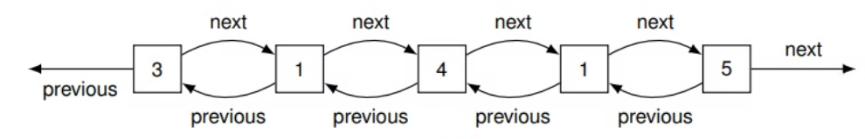
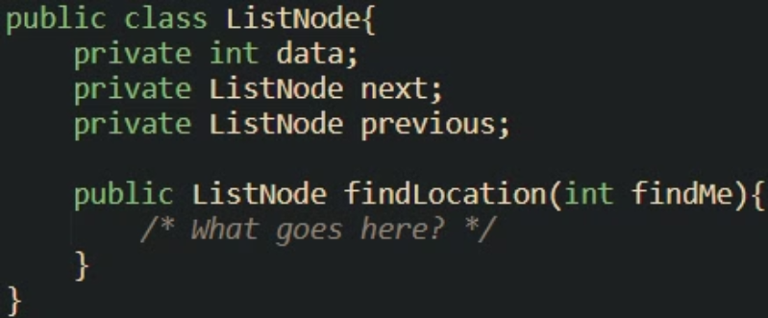
Example
Problem:
Given: a data structure, and a target value(s) to find.
Question: Is target value(s) in the structure? If yes, where?
Approach 2: Using linked list

Slide 18
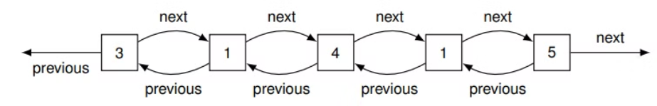
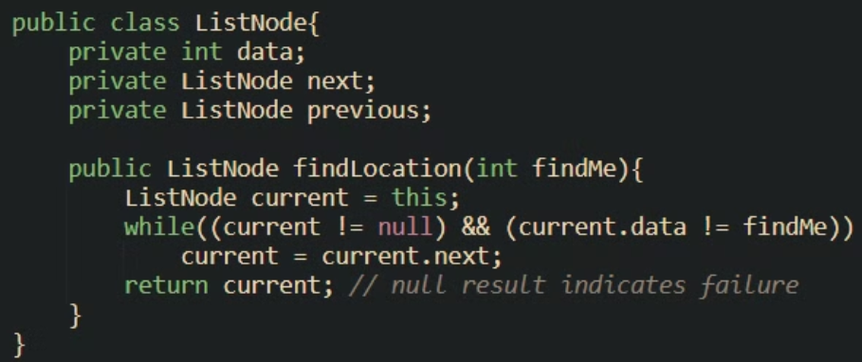
Example
Problem:
Given: a data structure, and a target value(s) to find.
Question: Is target value(s) in the structure? If yes, where?
Approach 2: Using linked list

Slide 19
Brute force algorithms
Linear search is an example of a Brute Force algorithm:
In order to find a solution, look at all possible candidates.
On the one hand, this works for many different data structures.
On the other hand, it ignores the benefits that suitable data structures offer.
Often the easiest algorithm to implement.
Usually not optimal and inefficient.

Slide 20

Is there a smarter way?
Do we have to use the hard way all the time?

Slide 21
Linear Search → Binary Search
We had to potentially look at each value in the array/list.
Can we do better?
Yes, if the container is:
indexable
sorted
Idea:
Check the middle element (This is what we need indexability for)
If it is. . .
what we are looking for: success, return this index
less: repeat with just the right half
greater: repeat with just the left half
Repeat until no candidates left
Return -1 to indicate failure if this happens

Slide 22
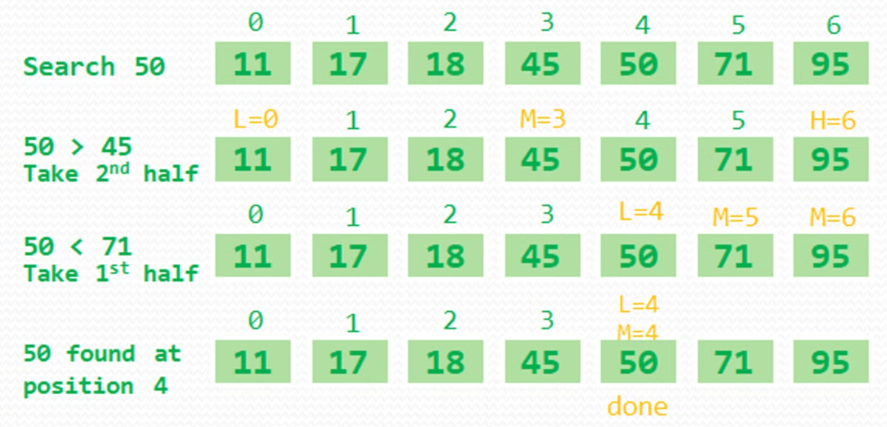
Binary Search: Example

Slide 23
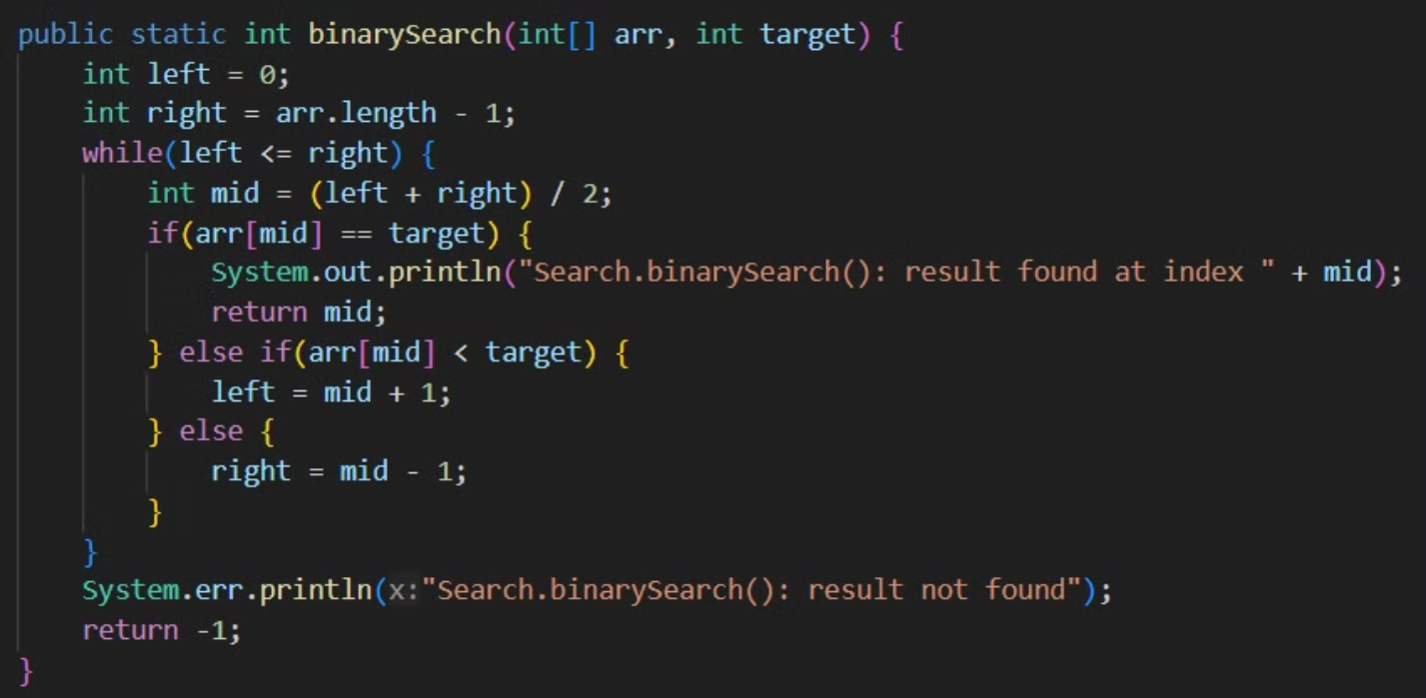
Binary Search: Implementation

Slide 24

Binary Search: Complexity?
Each iteration cuts the search range in half
If the array has size n, and n is less than 2k :
After 1 iteration there are less than 2k−1 candidates left
After 2 iterations there are less than 2k−2 candidates left
. . .
After k − 1 iterations there are less than 2 candidates left
The search finishes after at most k = ⌈log n⌉ iterations.
So BigO complexity of binary search is O(log n)
Think about what happens if we try this with a linked list
It relies on the data being indexable and sorted
We will be looking at sorting soon

Slide 25
Divide and conquer
While linear search is a Brute Force algorithm, binary search uses a strategy called Divide and Conquer:
In order to solve a problem on a data structure,
Split the data structure into smaller parts
Solve the problem on each part
Get an overall solution from the partial solutions
How each step is done, depends on the problem

Slide 26
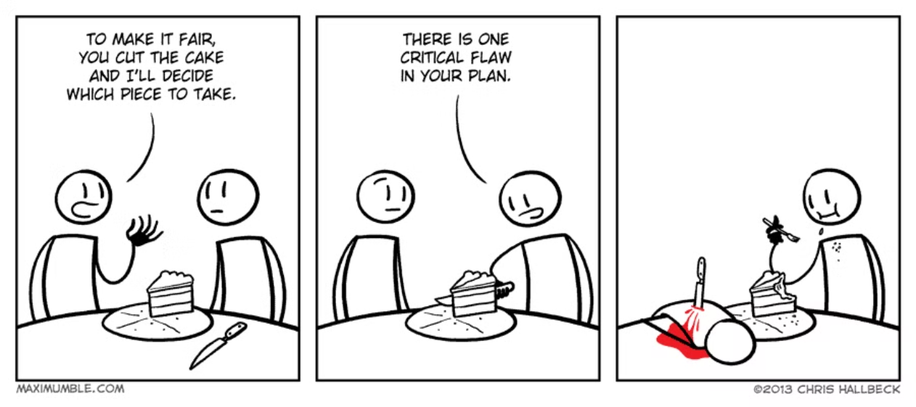
Divide and conquer: Binary Search
In binary search, the steps boil down to
If not found yet, split the array into the low and high half
Ignore the half where the value cannot be, use recursion on the other
Overall solution is the solution from the relevant half
Divide and Conquer is an important strategy, we will see more examples later!

Slide 27
Summary
Data structure classification
Why data structures matter?
Sequential data structures:
Array and ArrayLists
Linked Lists
Operations on Arrays and Linked Lists
Brute force algorithms
Linear Search on Arrays and Linked Lists
Implementation
Divide and conquer
Binary Search
Implementation

Slide 28
ArrayList operations
add() – takes O(1) time; however, worst-case scenario, when a new array has to be created and all the elements copied to it, it’s O(n)
add(index, element) – on average runs in O(n) time
get() – is always a constant time O(1) operation
remove() – runs in linear O(n) time. We have to iterate the entire array to find the element qualifying for removal.
indexOf() – also runs in linear time. It iterates through the internal array and checks each element one by one, so the time complexity for this operation always requires O(n) time.
contains() – implementation is based on indexOf(), so it’ll also run in O(n) time.

